Slide 1
Scheduling
Covers Chapter#09 from Textbook

Slide 2
Scheduling
In a multiprogramming system, multiple processes concurrently exist in main memory, and scheduling is the key to multiprogramming.
Processor Scheduling: to assign processes to be executed by the processor over time, in a way that meets system objectives, such as response time, throughput, and processor efficiency.
Three types of processor scheduling are involved:
Long-term scheduling
Medium term scheduling
Short-term scheduling

Slide 3
Types of Processor Scheduling
Scheduling affects system performance because it determines which processes will wait and which will progress.

Slide 5
Fundamentally, scheduling is managing queues to minimize queueing delay and optimize performance.

Slide 6
Long-Term Scheduling
The long-term scheduler determines which programs are admitted to the system for processing. Thus, it controls the degree of multiprogramming.
In the batch portion of an OS, newly submitted jobs are routed to disk and held in a batch queue. The long-term scheduler creates processes from the queue when it can.
The long-term scheduler must decide the following:
When OS can take one or more additional processes.
Which job(s) to accept and turn into processes.
In terms of frequency of execution, the long-term scheduler executes relatively infrequently.

Slide 7
Medium-Term Scheduling
Part of the swapping function.
Swapping-in decisions are based on the need to manage the degree of multiprogramming.
The medium-term scheduler is executed somewhat more frequently, compared to long-term scheduler, to make a swapping decision.

Slide 8
Short-Term Scheduling
The short-term scheduler, also known as the dispatcher, makes fine-grained decision of which process to execute next.
Invoked whenever an event occurs that may lead to the blocking of current process or that may provide an opportunity to preempt a currently running process in favor of another. E.g.
Executes most frequently as compared to other scheduling.
Clock interrupts | I/O interrupts
Operating system calls | Signals

Slide 9
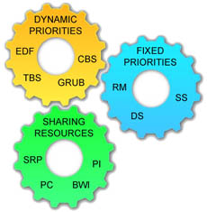
Scheduling Algorithms

Slide 10
Short-Term Scheduling Criteria
Main objective of short-term scheduling is to allocate processor time in such a way as to optimize one or more aspects of system behavior.
Generally, a set of criteria is established against which various scheduling policies may be evaluated.
Commonly used criteria can be categorized along two dimensions:
User-oriented and system-oriented criteria.
Performance related and not directly performance related criteria.

Slide 11
Short-Term Scheduling Criteria (Cont.)
User-oriented criteria: relate to behavior of the system as perceived by individual user or process.
E.g. response time in an interactive system.
Response time: is the elapsed time between the submission of a request until the response begins to appear as output.
System-oriented criteria: focus is on effective and efficient utilization of the processor.
E.g. throughput
Throughput: is the rate at which processes are completed.

Slide 12
Short-Term Scheduling Criteria (Cont.)
Performance related criteria: quantitative and generally can be measured.
E.g. response time and throughput.
Not performance related: either qualitative in nature or do not lend themselves to measurement and analysis.
E.g. predictability.
Predictability: a given job should run in about the same amount of time and at about the same cost regardless of the load on the system.
Scenario example: a wide variation in response time is distracting to users, which may signal a wide swing in system workloads or the need for system tuning to cure instabilities.

Slide 13
The Use of Priorities
In many systems, each process is assigned a priority and the scheduler will always choose a process of higher priority over one of lower priority.
Instead of a single ready queue, we provide a set of queues in descending order of priority. RQ0, RQ1, . . . , RQn
When a scheduling selection is to be made, the scheduler will start at the highest-priority ready queue (RQ0).
If there are one or more processes in the queue, a process is selected using some scheduling policy.
If RQ0 is empty, then RQ1 is examined, and so on.
Note: in UNIX and many other systems, larger priority values represent lower priority processes (we follow this convention).

Slide 14
The Use of Priorities (Cont.)
One problem with a pure priority scheduling scheme is that lower-priority processes may suffer starvation.
This will happen if there is always a steady supply of higher-priority ready processes.
If this behavior is not desirable, the priority of a process can change with its age or execution history.

Slide 15
Alternative Scheduling Policies
The selection function determines which process, among ready processes, is selected next for execution.
The selection function may be based on execution characteristics of the process in which three quantities are significant:
w = time spent in system so far, waiting
e = time spent in execution so far
s = total service time required by the process
E.g. the selection function max[w] indicates an FCFS discipline.

Slide 16
Alternative Scheduling Policies (Cont.)
Decision mode: specifies the instants in time at which the selection function is exercised.
There are two general categories for decision mode:
Nonpreemptive: In this case, once a process is in the Running state, it continues to execute until (a) it terminates or (b) it blocks itself to wait for I/O or to request some OS service.
Preemptive: The currently running process may be interrupted and moved to Ready state by OS.
Pros: provide better service to total processes population, due to preventing any process from monopolizing the processor for very long.
Cons: incur greater overhead than nonpreemptive.

Slide 17
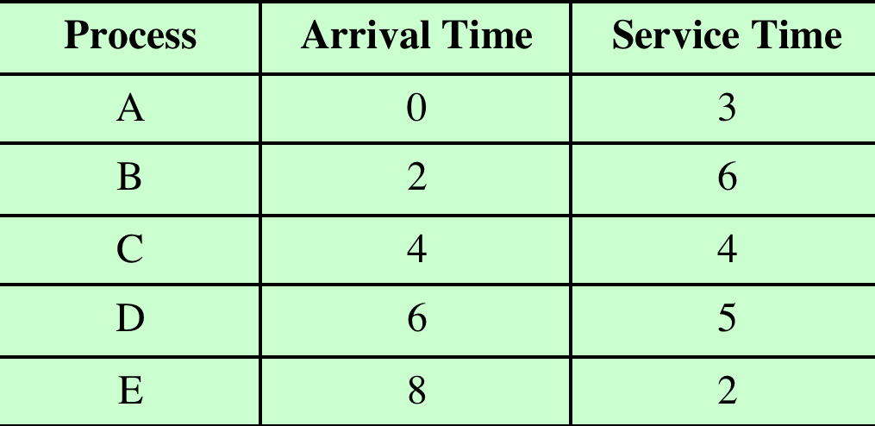
Alternative Scheduling Policies (Cont.)
Service time being total execution time required.
Alternatively, the service times represent the processor time required in one cycle.
Table 9.4
Process Scheduling Example

Slide 18
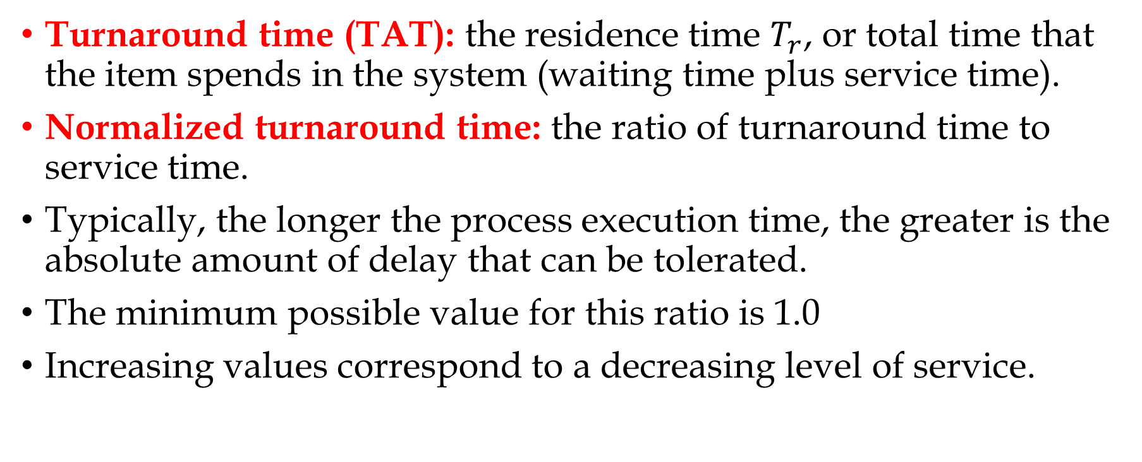
Alternative Scheduling Policies (Cont.)
Turnaround time (TAT): the residence time $T_{r}$, or total time that the item spends in the system (waiting time plus service time).
Normalized turnaround time: the ratio of turnaround time to service time.
Typically, the longer the process execution time, the greater is the absolute amount of delay that can be tolerated.
The minimum possible value for this ratio is 1.0
Increasing values correspond to a decreasing level of service.

Slide 19
Thank You!

